Slide 1

CHINOOK MUSIC SERVICE

Slide 2

Chinook Music Service
Chinook is a music service that offers a digital music platform, primarily focused on providing a comprehensive collection of songs and albums for users to explore and enjoy. The service allows users to browse and search for music across various genres, artists, and labels.

Slide 3
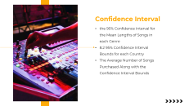


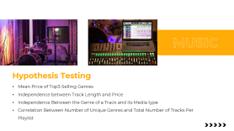
We will discuss about:
Some Information
Key Value
Hypothesis Testing
Confidence Interval

Slide 4

Key Values:
Number of Tracks per Album
Number of Albums per Artist
Tracks Durations
Total Purchases per Customer

Slide 5
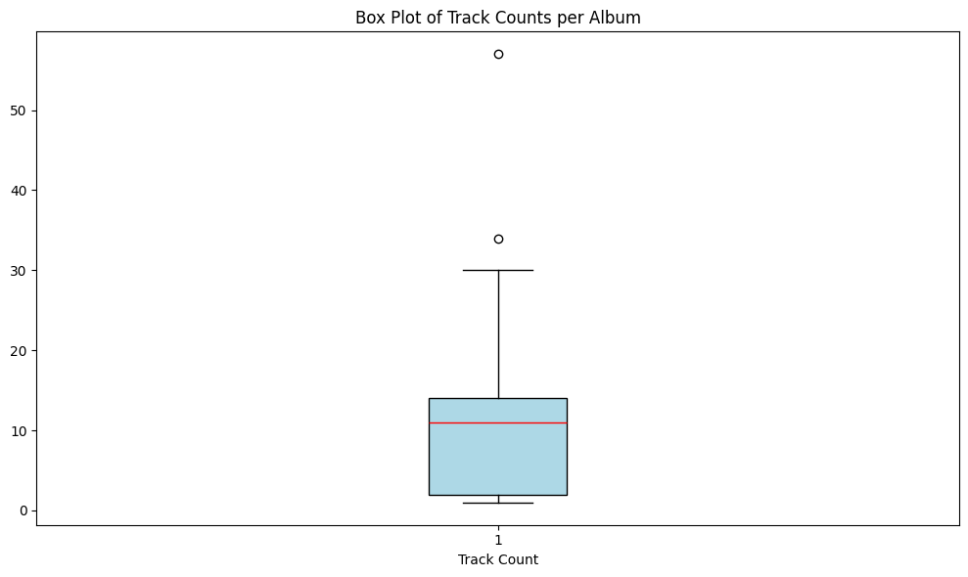
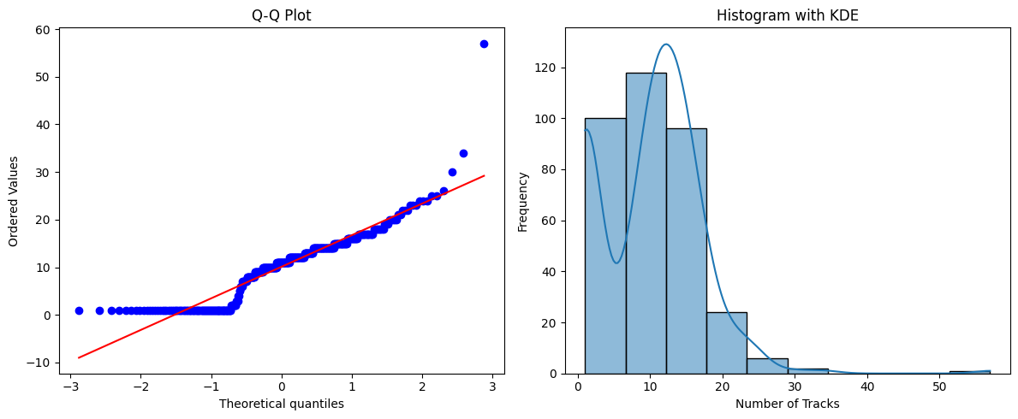
Number of Tracks per Album
By Shapiro-Wilk Statistic test the data does not follow a normal distribution

Slide 6
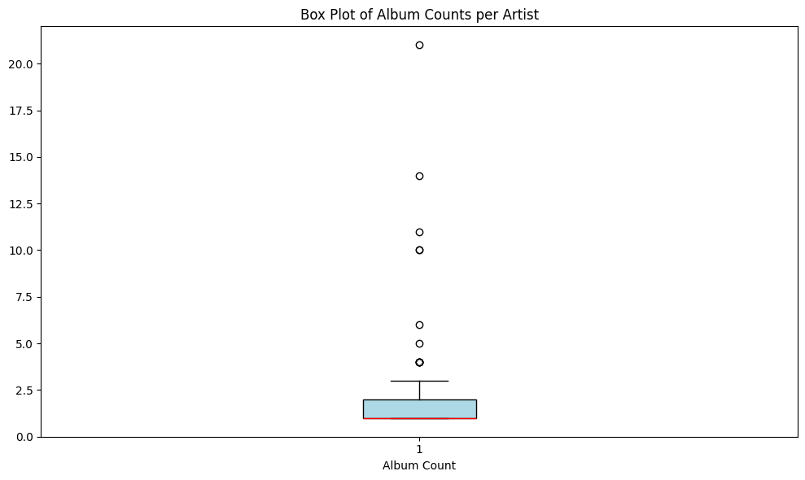
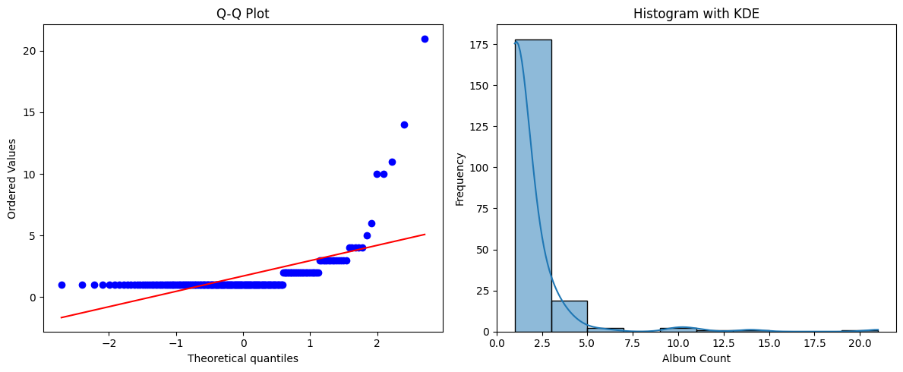
Number of Albums per Artist
By Shapiro-Wilk Statistic test the data does not follow a normal distribution

Slide 7
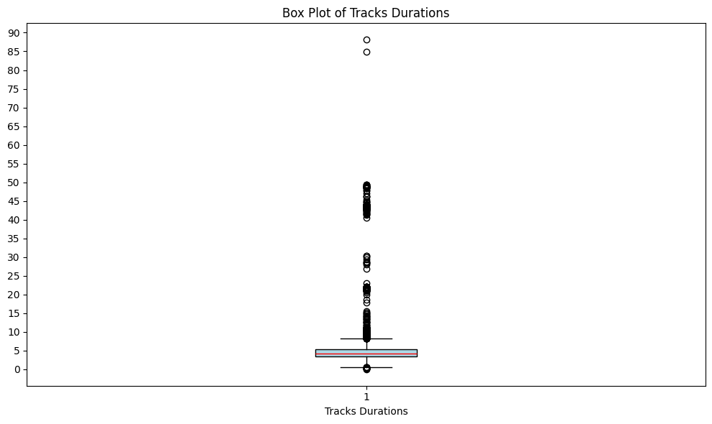
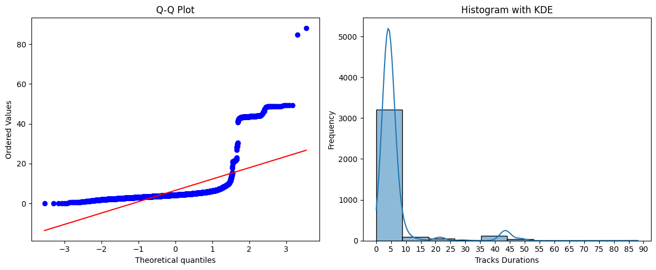
Tracks Durations
By Shapiro-Wilk Statistic test the data does not follow a normal distribution

Slide 8
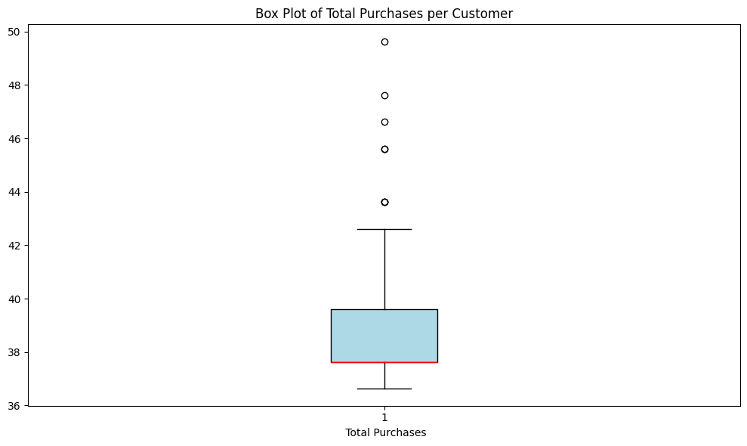
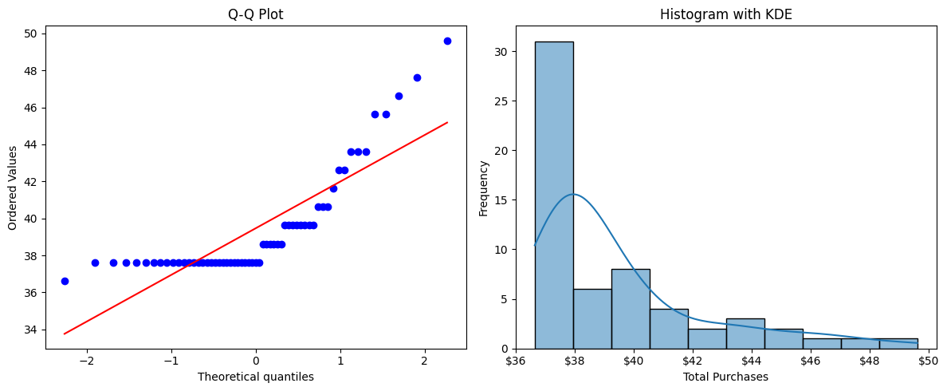
Total Purchases per Customer
By Shapiro-Wilk Statistic test the data does not follow a normal distribution

Slide 9

Some Information:
Total Revenue by Month
Customer Retention
Top Genres by Revenue
Total Revenue Contributed by each Employee

Slide 10
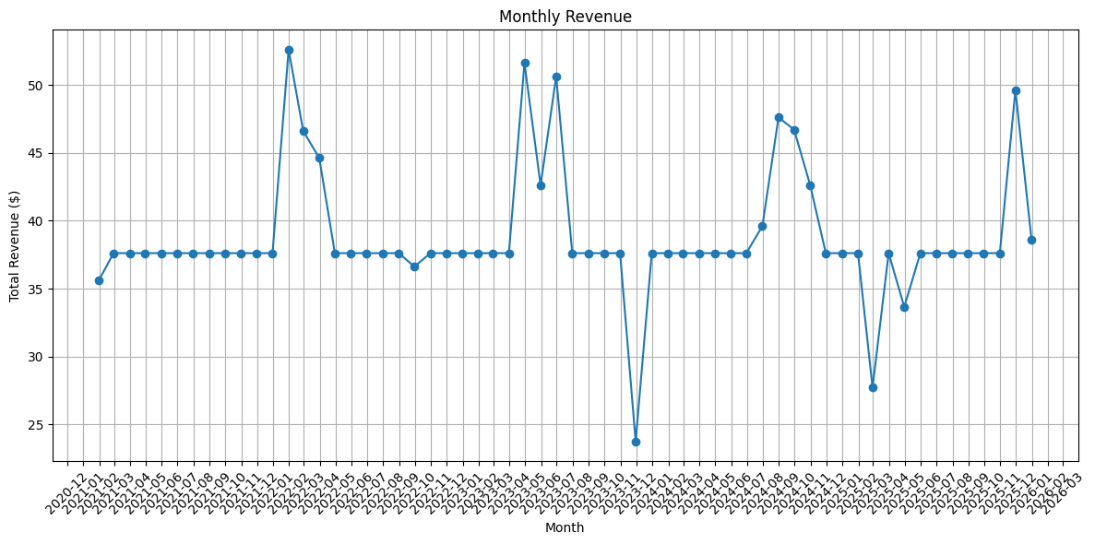
Total Revenue by Month
Data is for 2020/12 till 2026/03
2022/01 was our best month
2023/11 was our worst month

Slide 11
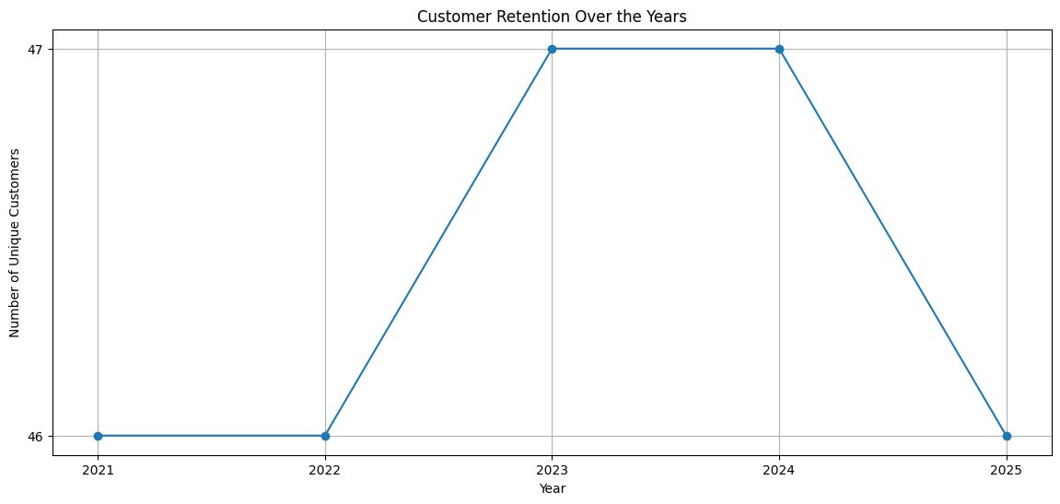
Customer Retention
Every year we have about 47 customers

Slide 12
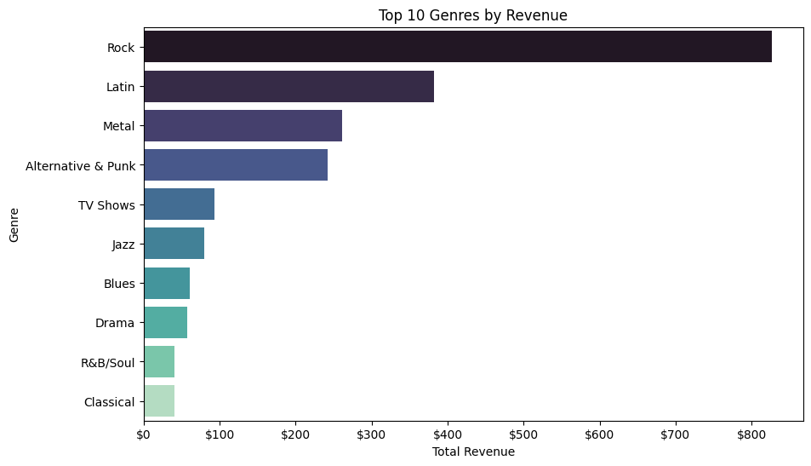
Top Genres by Revenue
Rock genre has most revenue about 800$

Slide 13
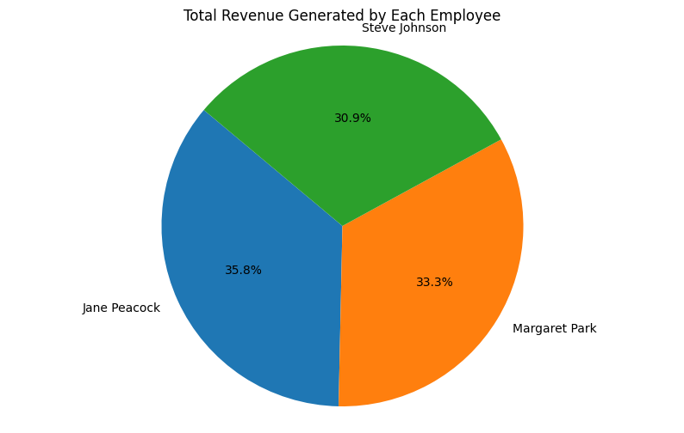
Total Revenue Contributed by each Employee
Jane Peacock is our best seller

Slide 14

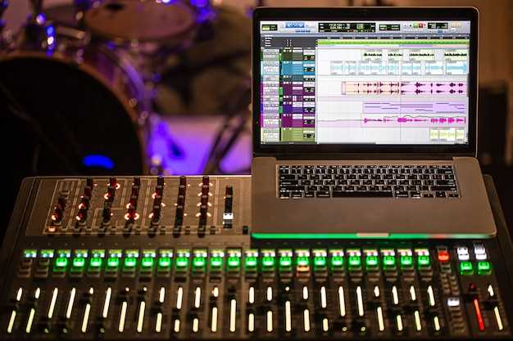
Hypothesis Testing
Mean Price of Top3-Selling Genres
Independence between Track Length and Price
Independence Between the Genre of a Track and its Media type
Correlation Between Number of Unique Genres and Total Number of Tracks Per Playlist

Slide 15
Mean Price of Top3-Selling Genres
Genre | Number of tracks sold
Rock | 835
Latin | 386
Metal | 264
T-test Results:
Genre Rock vs Genre Latin: the means of the two groups are significantly different
Genre Rock vs Genre Metal: the means of the two groups are likely similar
Genre Latin vs Genre Metal: the means of the two groups are significantly different

Slide 16


Independence between Track Length and Price
Pearson correlation coefficient:
There is a significant correlation between track length and price.
Independence Between the Genre of a Track and its Media type
Chi-square statistic:
There is a significant association between genre and media type.

Slide 17
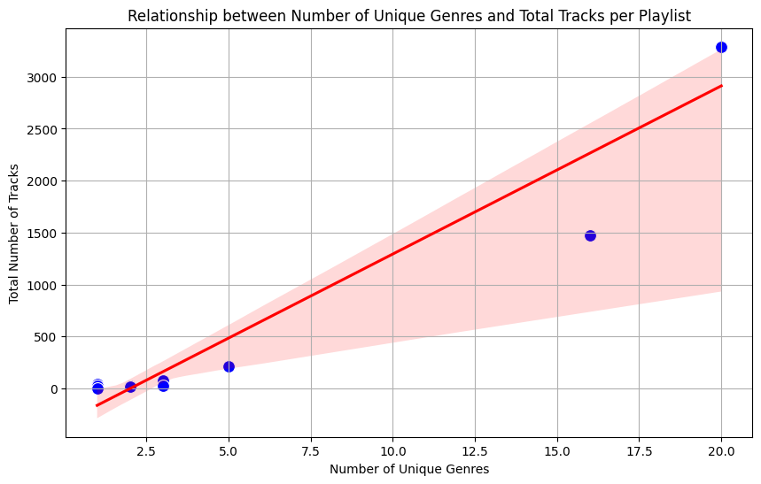
Correlation Between Number of Unique Genres and Total Number of Tracks Per Playlist
More genre in media type = more tracks in media type

Slide 18

Confidence Interval
the 95% Confidence Interval for the Mean Lengths of Songs in each Genre
8.2 95% Confidence Interval Bounds for each Country
The Average Number of Songs Purchased Along with the Confidence Interval Bounds

Slide 19
the 95% Confidence Interval for the Mean Lengths of Songs in each Genre
Rock & Roll has lowest length
Sci Fi & Fantasy has highest length
Name | Mean | Lower | Upper
Alternative | 4.40 | 3.96 | 4.83
Alternative & Punk | 3.90 | 3.76 | 4.04
Blues | 4.50 | 4.14 | 4.86
Bossa Nova | 3.65 | 2.92 | 4.39
Classical | 4.89 | 4.37 | 5.42
Comedy | 26.42 | 22.84 | 29.99
Drama | 42.92 | 40.76 | 45.07
Easy Listening | 3.15 | 2.85 | 3.45
Electronica/Dance | 5.04 | 4.57 | 5.52
Heavy Metal | 4.95 | 4.21 | 5.69
Hip Hop/Rap | 2.96 | 2.52 | 3.41
Jazz | 4.86 | 4.48 | 5.23
Name | Mean | Lower | Upper
Latin | 3.88 | 3.78 | 3.97
Metal | 5.16 | 4.97 | 5.34
Opera | 2.91 | Nan | Nan
Pop | 3.81 | 3.43 | 4.20
R&B/Soul | 3.66 | 3.39 | 3.94
Reggae | 4.11 | 3.93 | 4.30
Rock | 4.73 | 4.61 | 4.84
Rock & Roll | 2.24 | 2.02 | 2.46
Sci Fi & Fantasy | 48.52 | 48.10 | 48.95
Science Fiction | 43.75 | 43.44 | 44.07
Soundtrack | 4.07 | 3.75 | 4.39
TV Shows | 35.75 | 33.30 | 38.19
World | 3.74 | 3.40 | 4.09

Slide 20
95% Confidence Interval Bounds for each Country
Billing Country | Mean | Lower | Upper
Argentina | 5.37 | 1.08 | 9.66
Australia | 5.37 | 1.08 | 9.66
Austria | 6.08 | 0.29 | 11.88
Belgium | 5.37 | 1.08 | 9.66
Brazil | 5.43 | 3.94 | 6.91
Canada | 5.42 | 4.26 | 6.58
Chile | 6.66 | 0.54 | 12.77
Czech republic | 6.44 | 2.36 | 10.52
Denmark | 5.37 | 1.08 | 9.66
Finland | 5.94 | 1.61 | 10.27
Germany | 5.58 | 3.77 | 7.40
Hungary | 6.51 | -0.23 | 13.26
Name | Mean | Lower | Upper
India | 5.78 | 3.15 | 8.42
Ireland | 6.51 | -0.23 | 13.26
Italy | 5.37 | 1.08 | 9.66
Netherlands | 5.8 | 1.33 | 10.27
Norway | 5.66 | 0.78 | 10.53
Poland | 5.37 | 1.08 | 9.66
Portugal | 5.51 | 2.85 | 8.17
Spain | 5.37 | 1.08 | 9.66
Sweden | 5.51 | 1.19 | 9.83
USA | 5.74 | 4.73 | 6.75
United Kingdom | 5.37 | 3.37 | 7.37
Rock & Roll has lowest length
Sci Fi & Fantasy has highest length

Slide 21
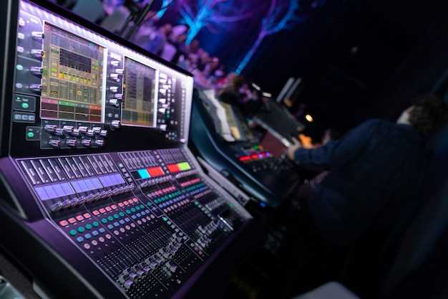
The Average Number of Songs Purchased Along with the Confidence Interval Bounds
Average number of tracks purchased per Customer: 37.97
95% confidence interval: (37.90, 38.03)

Slide 22





Thank You!
We respect your valuable time with Chinook!
If you have any questions, please reach us
www.chinookmusicservice.com

